Slide 1
GLOBAL FROG GAMES
SENIOR DESIGN 2019
Notes:
Westen: “Hello I’m Westen Riley and this is Sellars Levy and we are part of the Global Frog Games senior design team.”

Slide 2
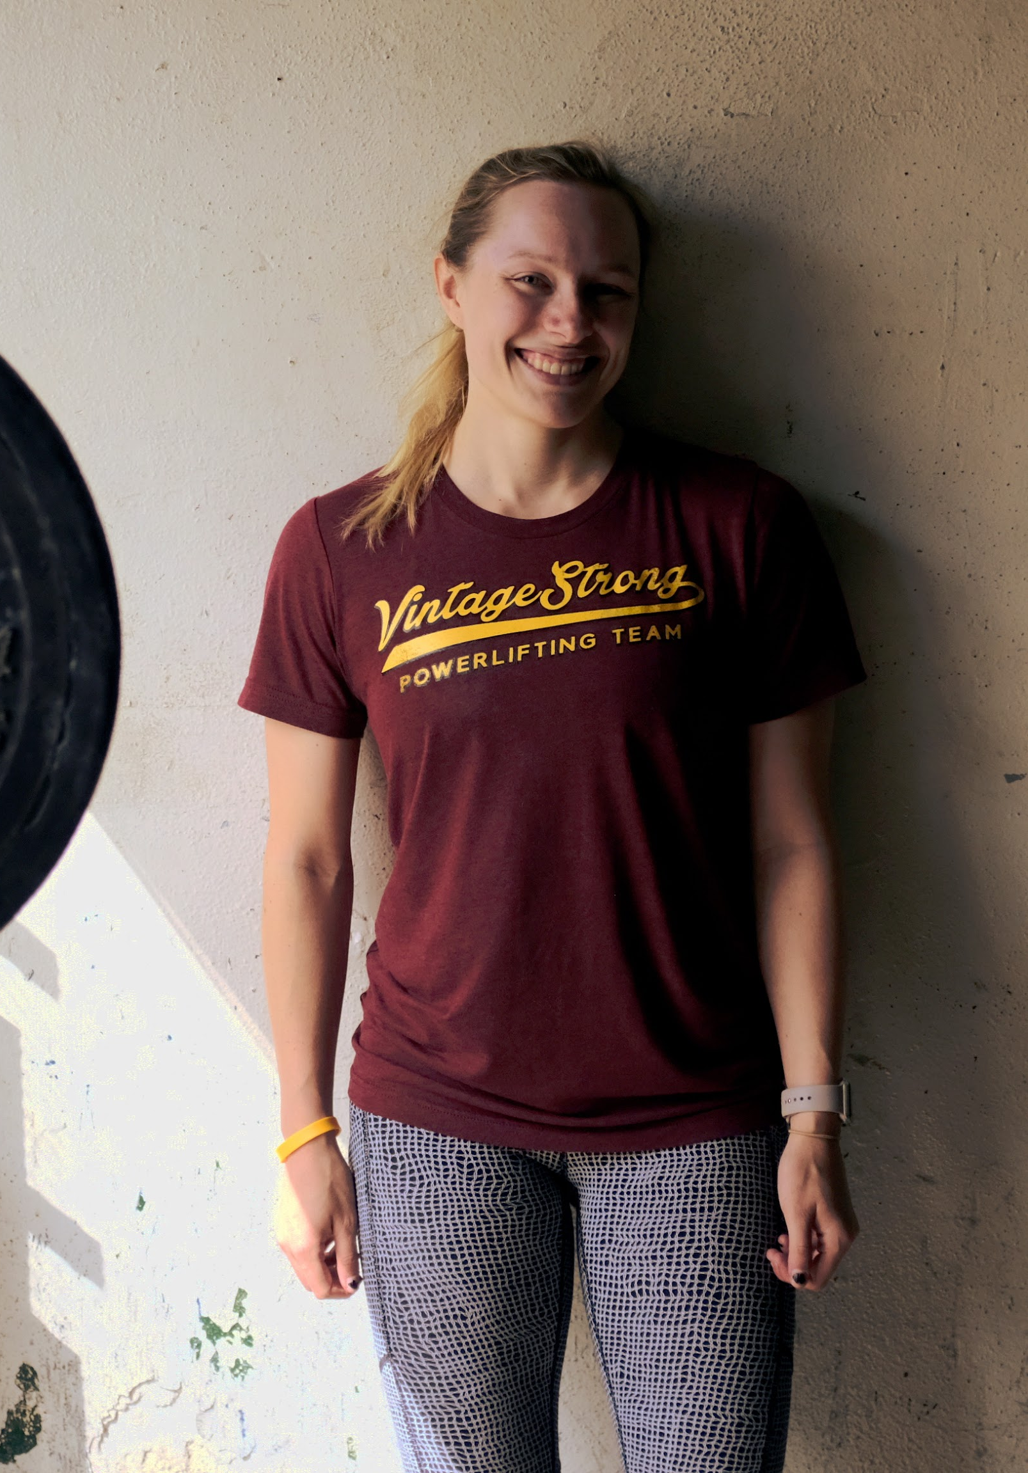
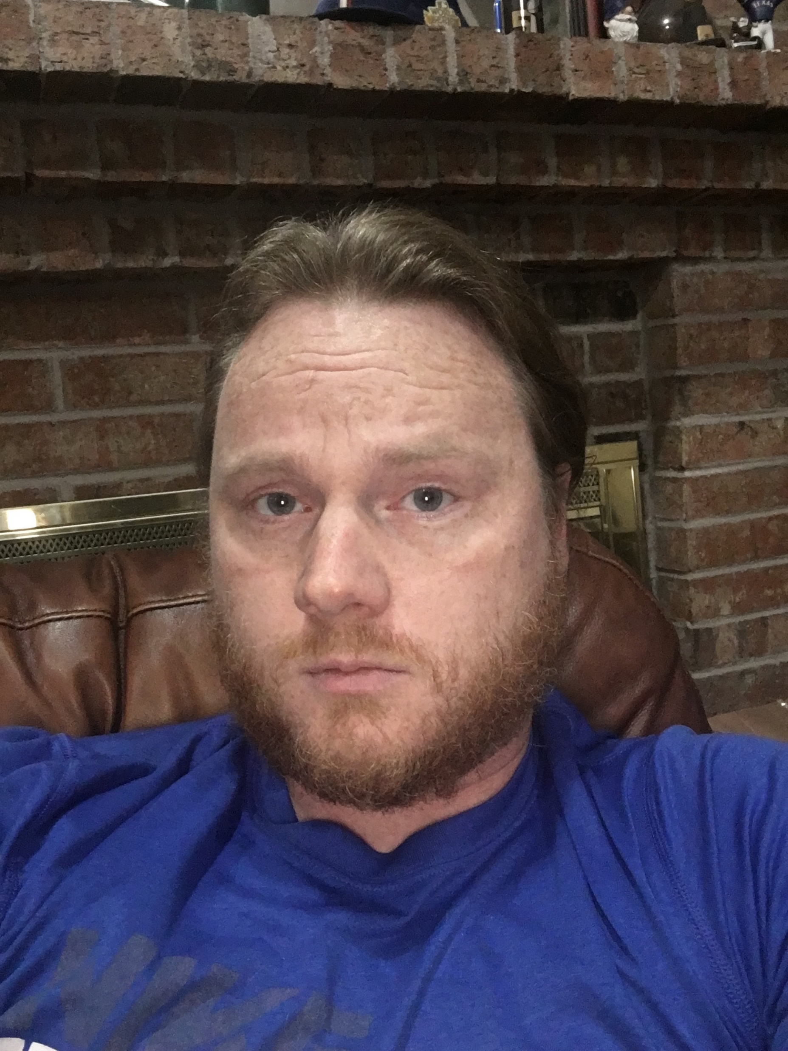
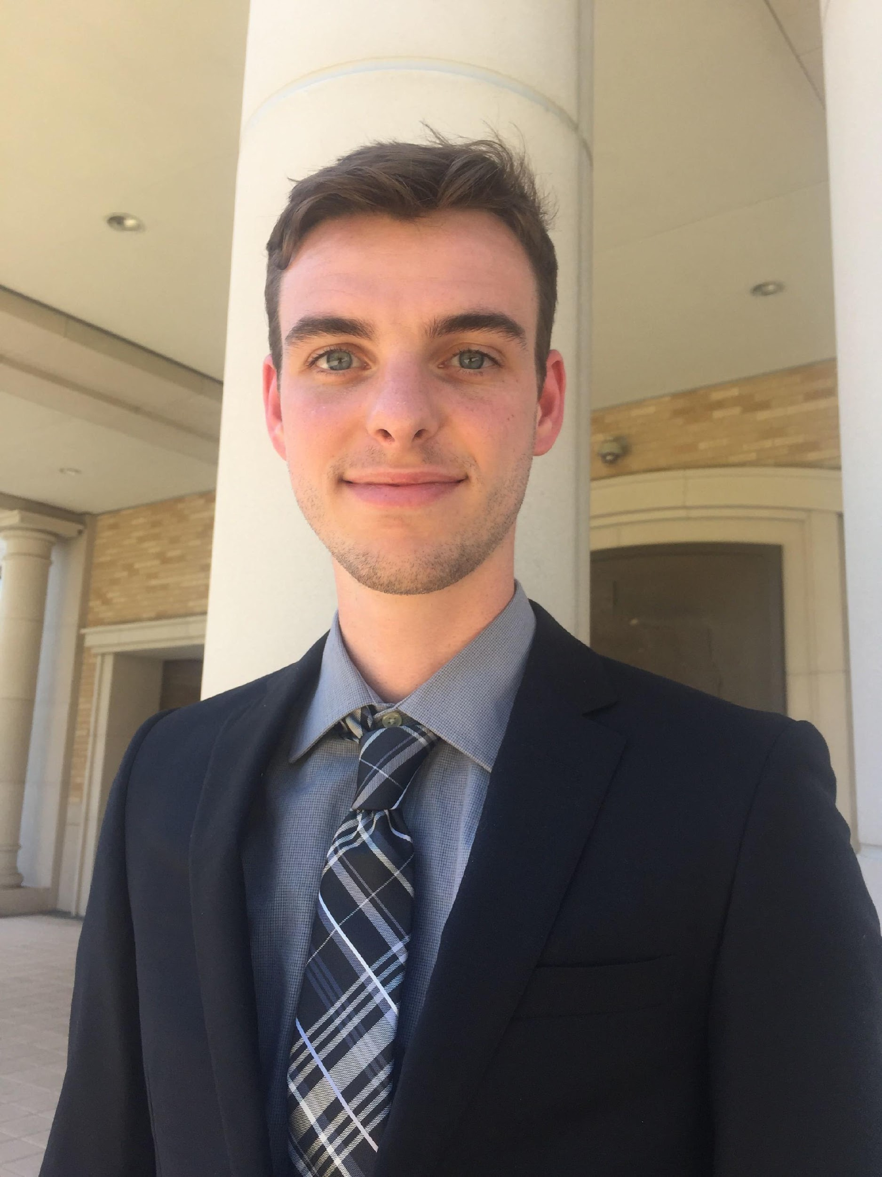
TEAM MEMBERS
Brooke Smith – COSC – Team Lead
David Rasberry – CITE – Website Manager
Shane Mitchell – CITE – Artist/Programmer
Notes:
Our team members are Brooke Smith, the Team Lead. David Rasberry, the Website manager. Shane Mitchell the artist and Programmer.

Slide 3
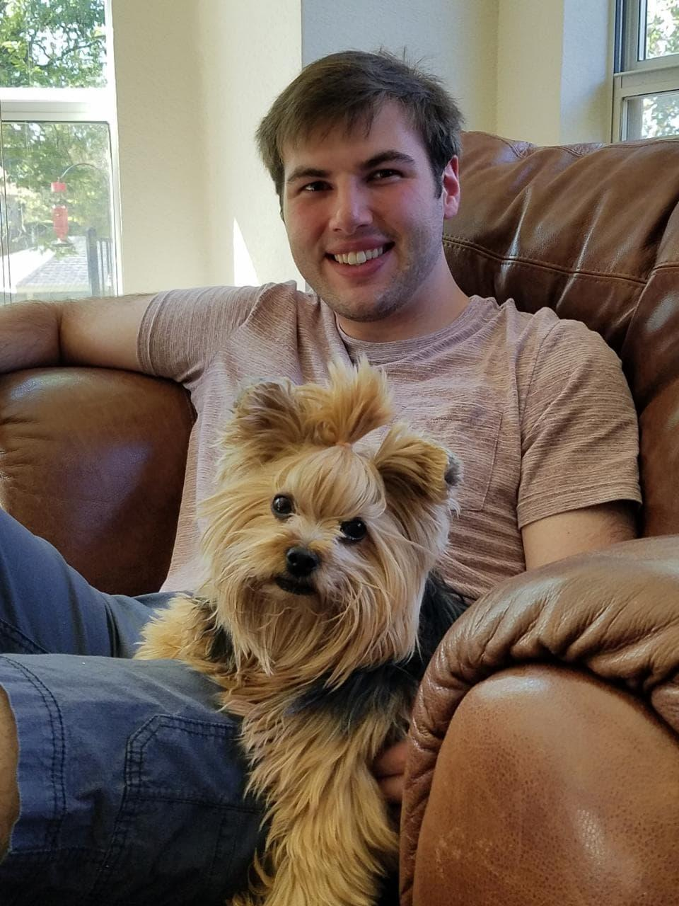
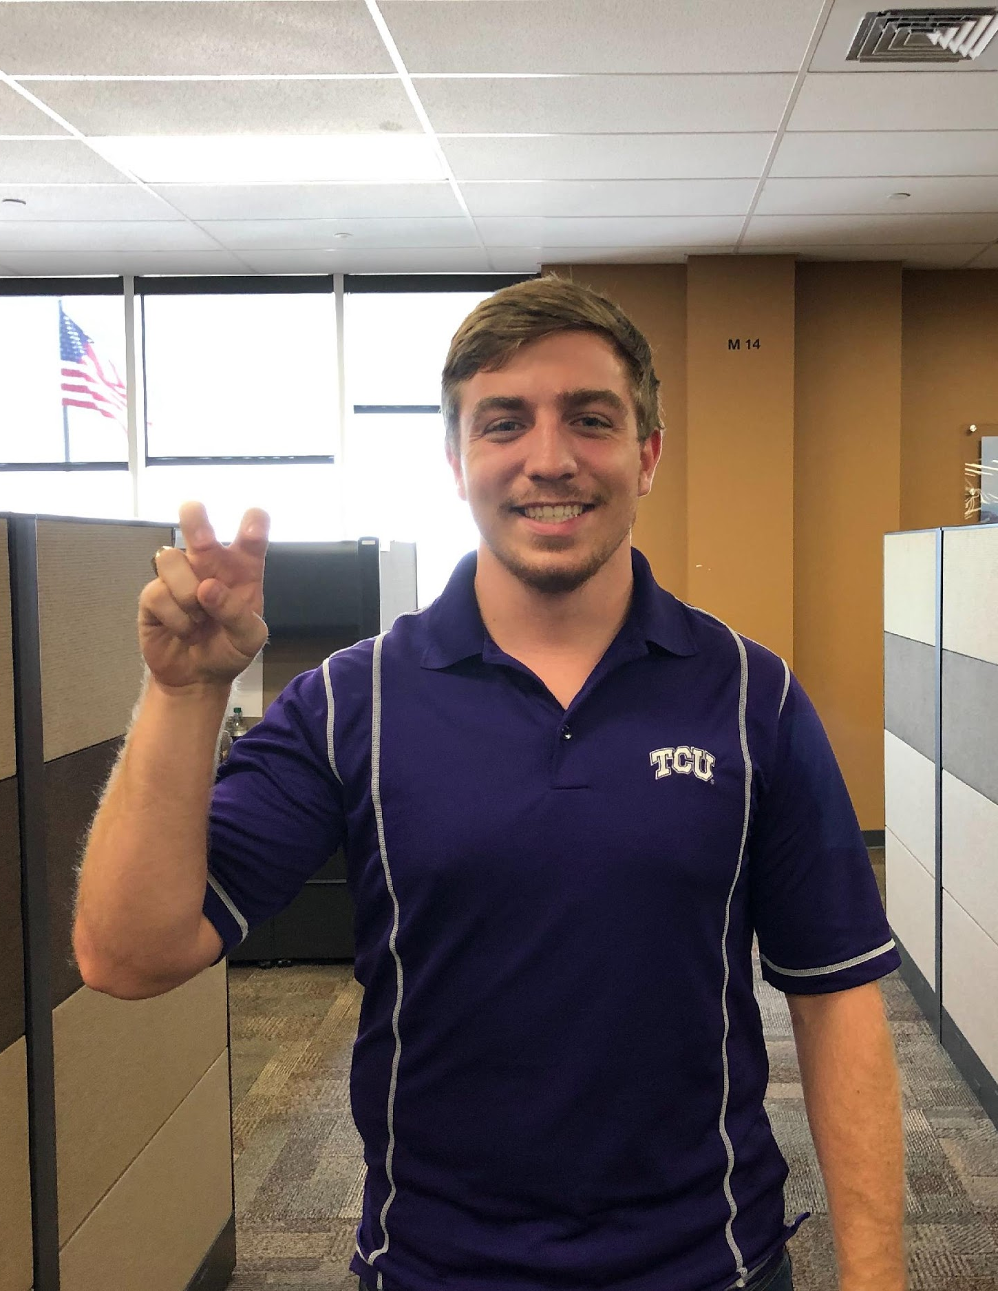
TEAM MEMBERS
Nick Bonavia – COSC – Programmer
Sellars Levy – COSC – Programmer
Westen Riley – COSC - Programmer
Notes:
we also Nick Bonavia, a programmer. And then myself and Sellars who are programmers as well.

Slide 4
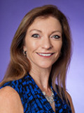
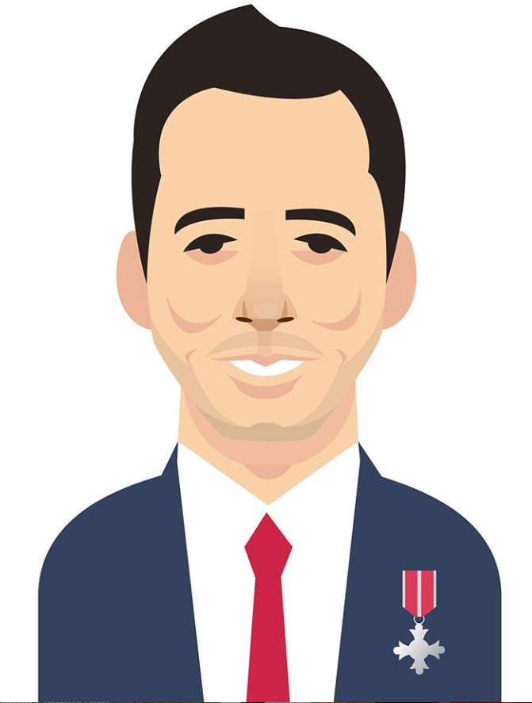
OUR CLIENT
Professor Samantha Davis
Associate Professor in the Department of Nutritional Sciences
Works with Sir Stanley Matthews Coaching Foundation
Sir Stanley Matthews Coaching Foundation
Giving opportunities to kids to play sports
Inspiring kids to to be active and healthy
Notes:
First off we will introduce our Clients. Professor Samantha Davis is an Associate Professor here at TCU in the Department of Nutritional Sciences. She is working with the Sir Stanley Matthews Foundation to help find a solution to the problem we will discuss. Next is The Sir Stanley Matthews Foundation which was founded in honor of Sir Stanley Matthews, a legendary soccer player (or football across the pond). Their aim is to give children as many opportunities to play sports as they can so that they will be healthy and active.

Slide 5
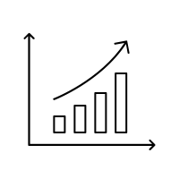
ISSUES TO BE SOLVED
Childhood Obesity rates are increasing
Children lack knowledge for living a healthy lifestyle
Children are less active now than previous generations
Notes:
The issues presented to us are about the increasing childhood obesity rates, the lack of knowledge children have about living a healthy lifestyle, and how children are less active now than ever before. With the United States leading in Childhood obesity rates, and the United Kingdom not far behind we were tasked with building an app to help fight this problem.

Slide 6
OUR APP
Sir Stanley's Well Rounded Adventure
The use of fun mini-games will keep children engaged and interested
The app will provide useful knowledge about nutrition and healthy habits
Notes:
Our app is called Sir Stanley’s Well Rounded Adventure.
The game is comprised of mini-games that will help teach children learn about nutrition and healthy habits. Each minigame will have a tutorial that will teach the child about an aspect about these topics.
For example, we have designed a matching classification game where kids must match various foods based off of their food group such as matching the picture of the banana to the word fruit.
This will provide entertainment as well as teach the child what makes up a nutritious meal. Through these mini-games we can teach information that can help children make better decisions for themselves and motivate them to be active and have fun.

Slide 7
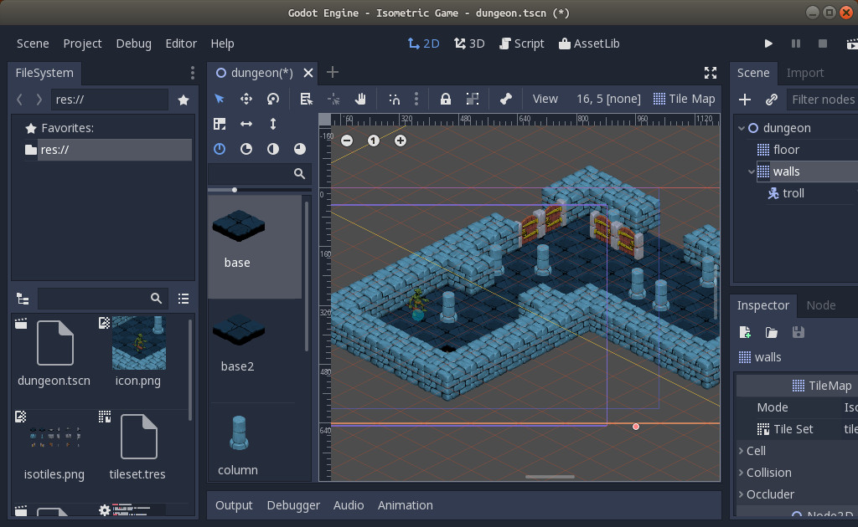
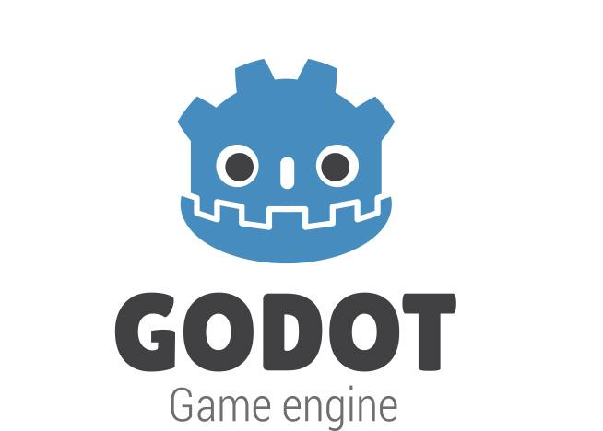
OUR APP (CONT.)
GODOT is a free, open source, game engine
It can produce applications that can run on Both iOS and Android
Notes:
Our app will be built in a free, versatile game engine call GODOT. GODOT has an excellent 2d engine that will help us build Sir Stanley's Well Rounded Adventure with ease. It also has to capability to export iOS and Android apps so that no matter if the kid or their parents have iPhone or Android, they will not miss out on our game.

Slide 8
POSITION STATEMENT
Our app is for children (ages 6-11) who need to learn about nutrition, activity, and being a good citizen. Sir Stanley’s Well Rounded Adventure is a mobile game that is fun, educating, and motivational unlike traditional teaching methods. Our product will be an engaging and fun way to learn about having a healthy lifestyle.

